Slide 1
Embedded Systems
ADC Interfacing

Slide 2
What is an ADC?
An analog-to-digital converter (ADC, A/D or A2D) converts an analog signal to a digital signal, and a digital-to-analog converter (DAC, D/A or D2A) does the opposite.
An embedded system uses the ADC to collect information about the external world.
The input signal is usually an analog voltage, and the output is a binary number.

Slide 3
What is an ADC Interfacing?
Analog-to-Digital Converters (ADCs) are used to convert analog signals into digital representations that can be communicated and processed using digital logic.
A physical quantity which is analog in nature is converted to electrical signals using a device called transducers.
Transducers are also referred to as sensors.
Sensors produce an output that is voltage or current. Therefore, we need an ADC to translate the analog signals to digital numbers so that micro-controller can read and process them.

Slide 4
Why we need ADC Interfacing?
Such conversions are necessary because, while embedded systems deal with digital values, an embedded system’s surroundings typically involve many analog signals.
Analog refers to continuously-valued signal, such as temperature or speed represented by a voltage between 0 and 100, with infinite possible values in between.
Digital refers to discretely-valued signals, such as integers, and in computing systems, these signals are encoded in binary. By converting between analog and digital signals, we can use digital processors in an analog environment.

Slide 5
How many ADC bits are required?
The capacity of an ADC to encode an analogue input is 2 raise to the power n, where n= no. of bits of ADC.
The resolution of a DAC or ADC is defined as Vmax/(2n-1), representing the number of volts between successive digital encodings.
Example:
An ADC with a resolution of 8 bits can encode an analog input to one in 256 different levels (2⁸ = 256). The values can represent the ranges from 0 to 255 (i.e. unsigned integer) or from −128 to 127 (i.e. signed integer), depending on the application.

Slide 6

Working with ADC
We can compute the digital values from the analog values, and vice-versa, using the
following ratio:
Vmax (Vref) is the maximum voltage that the analog signal can assume,
n is the number of bits available for the digital encoding,
d (ADC-value) is the present digital encoding, and
e (Analogue-input) is the present analog voltage

Slide 7
Working with ADC
We can compute the digital values from the analog values, and vice- versa, using the
following ratio:
Suppose :
Vmax is 7.5V , e = 5V,
we have the following ratio:
5/7.5 = d/15,
d = 1010 (ten)

Slide 8
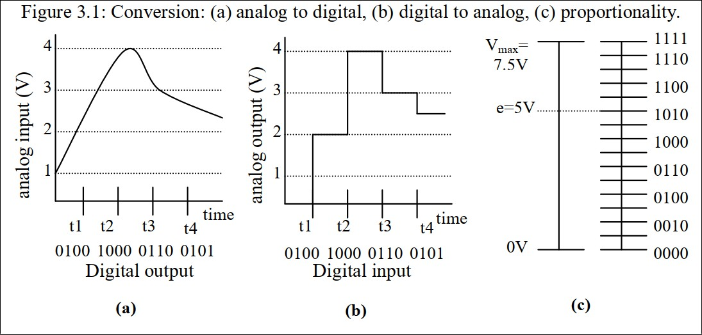
DACs vs ADCs

Slide 9
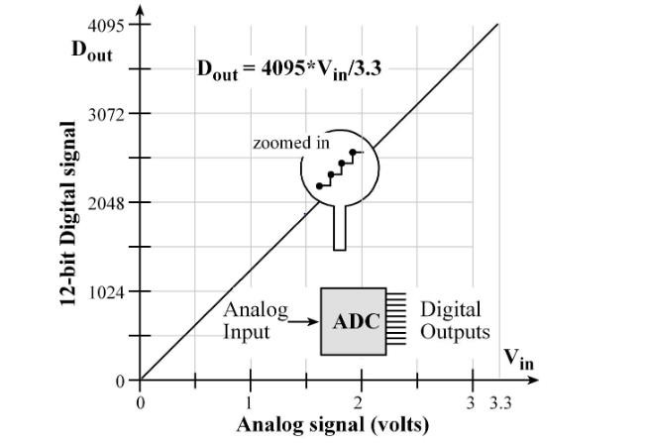
9

Slide 10
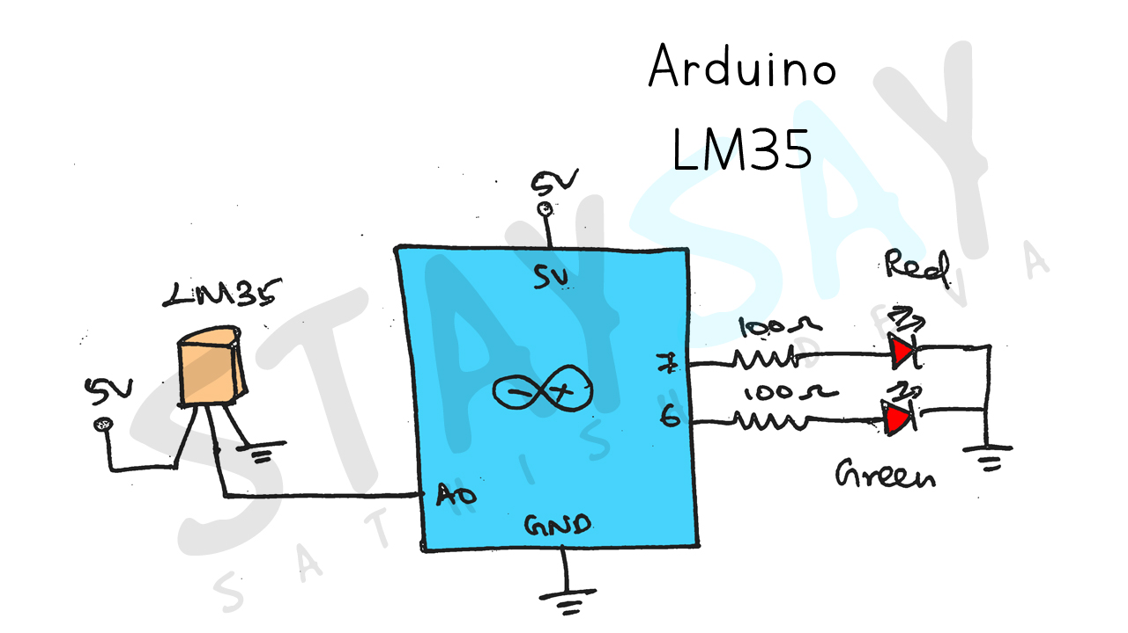

Slide 11
Temperature Sensor
#define LM35 A0
#define RED 7
#define GREEN 6
float lm_value;
float tempc;
void setup() {
Serial.begin(9600);
pinMode(RED, OUTPUT);
pinMode(GREEN, OUTPUT);
}
void loop() {
lm_value = analogRead(LM35);
tempc = (lm_value * 500) / 1023;
Serial.println(tempc);//Temperature in Celcius
//Condition
if (tempc > 60) {
digitalWrite(RED, HIGH);
digitalWrite(GREEN, LOW);
}
else {
digitalWrite(GREEN, HIGH);
digitalWrite(RED, LOW);
}
delay(100);
}

Slide 12
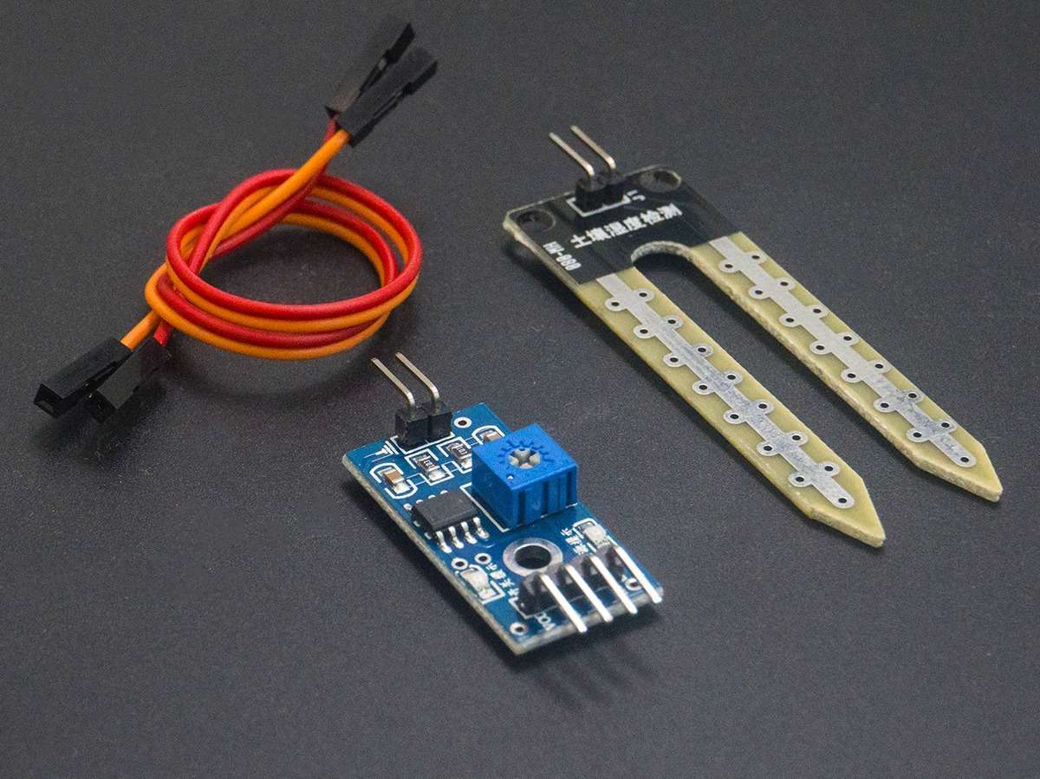
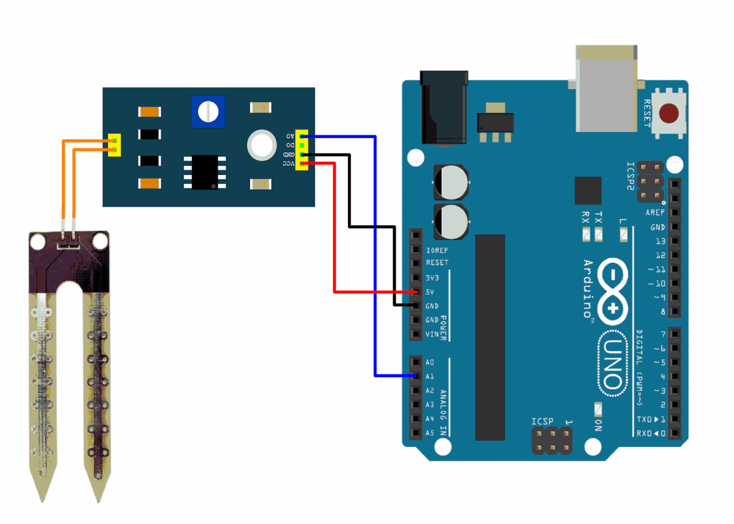
Soil Moisture
12

Slide 13
const int sensor_pin = A1; /* Soil moisture sensor O/P pin */
void setup(){
Serial.begin(9600); /* Define baud rate for serial communication */
}
void loop(){
float moisture_percentage;
int sensor_analog;
sensor_analog = analogRead(sensor_pin);
moisture_percentage = ( 100 - ( (sensor_analog/1023.00) * 100 ) ); Serial.print("Moisture Percentage = ");
Serial.print(moisture_percentage);
Serial.print("%\n\n");
delay(1000);
}

Slide 14
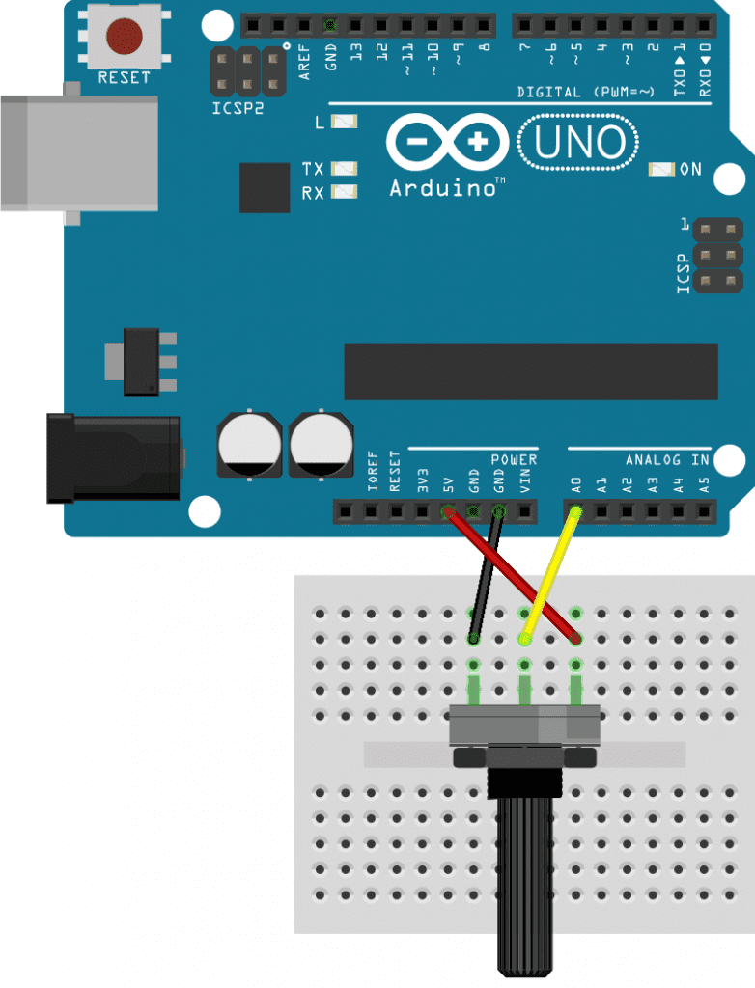
Voltage Level using Variable Resistor
How?
void setup() {
Serial.begin(9600);
}
void loop() {
int rawValue = analogRead(A0);
Serial.println(rawValue);
delay(100);
}
14

Slide 15
Voltage Level using Variable Resistor
How?
void setup() {
Serial.begin(9600);
}
void loop() {
int rawValue = analogRead(A0);
float voltage = rawValue * (5.0 / 1023.0);
Serial.print(voltage);
Serial.println(" Volts");
delay(100); }
rawValue=map(rawValue, sensorMin, sensorMax, 0, 255);
15

Slide 16
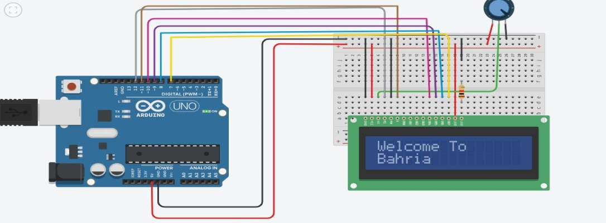
LCD Interface
PROGRAM:
#include<LiquidCrystal.h>
#include<LiquidCrystal.h>
LiquidCrystal lcd(12,11,10,9,8,7);
void setup()
{
lcd.begin(16,2);
}
void loop()
{
lcd.setCursor(0,0);
lcd.print("Welcome To");
lcd.setCursor(0,1);
lcd.print("Bahria");
}

Slide 17
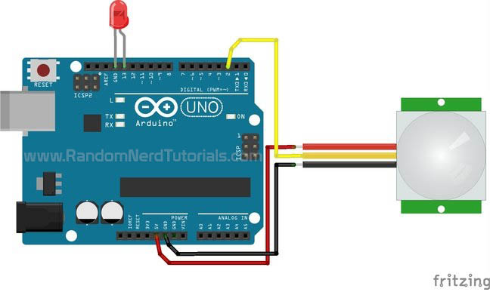
PIR Sensor
17

Slide 18
PIR Sensor
int sensor = 2; // the pin that the sensor is atteched to
int state = LOW; // by default, no motion detected
int val = 0; // variable to store the sensor status (value)
void setup() {
pinMode(led, OUTPUT); // initalize LED as an output
pinMode(sensor, INPUT); // initialize sensor as an input
Serial.begin(9600); // initialize serial
}
void loop(){
val = digitalRead(sensor); // read sensor value
if (val == HIGH)
{ // check if the sensor is HIGH
digitalWrite(led, HIGH); // turn LED ON
delay(100); // delay 100 milliseconds
Serial.println("Motion detected!");
}
else {
digitalWrite(led, LOW); // turn LED OFF
delay(200); // delay 200 milliseconds
Serial.println("Motion stopped!");
} }
18

Slide 19
Data Acquisition and Control Systems
The measurand is a real world signal of interest like sound, distance, temperature, force, mass, pressure, flow, light and acceleration. The control system uses an actuator to drive a measurand in the real world to a desired value while the data acquisition system has no actuator because it simply measures the measurand in a nonintrusive manner.
Measurand: A physical quantity or property which is being measured.
19

Slide 20
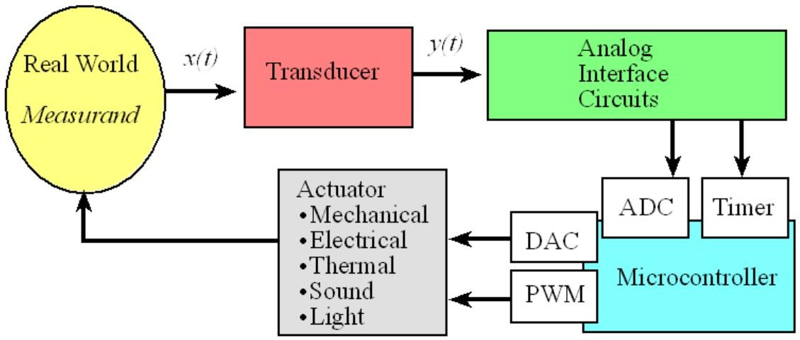
Data Flow Graph
20

Slide 21
Question?
21

